Slide 1
Week 1

Slide 2
Attention, Transformer and LLMs

Slide 3

The Transformer Architecture
Encoder: Processes the entire input sequence simultaneously to build a rich understanding of the context.
Decoder: Generates the output one step at a time, looking back at the Encoder's work to predict the next word.
Multi-Head Attention: The core mechanism. It allows the model to focus on different parts of the sentence to understand relationships.
Positional Encoding: Since the model processes words in parallel, this step adds mathematical tags to track the order of words.
Feed Forward & Add/Norm: Standard neural network layers that process the data and keep the math stable as the network gets deeper.

Slide 4
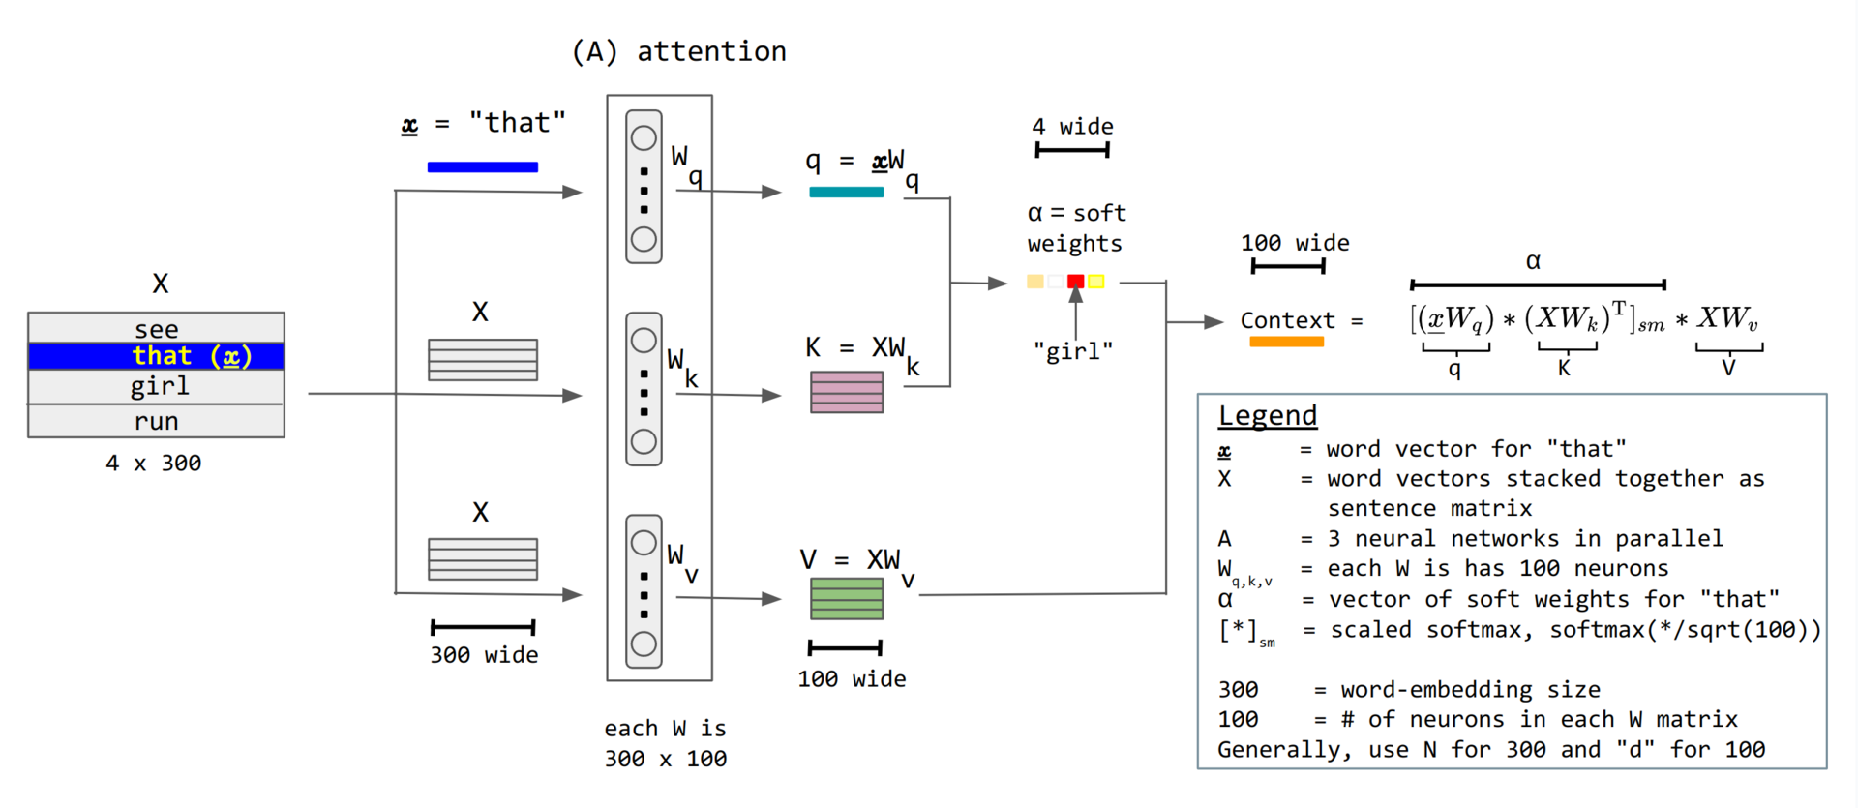
Attention

Slide 5
LLM Inference Phases
Prompt Phase (Parallel):
Processes the entire input prompt at once to predict the first token.
High Efficiency: Uses matrix-matrix operations to fully exploit GPU parallelism.
Generates the initial Key/Value vectors ($k_1...k_n$) for the sequence.
Autoregressive Generation (Sequential):
Generates remaining tokens one-by-one, reusing cached Key/Value vectors.
Memory-Bound: Relies on less efficient matrix-vector multiplication due to sequential data dependencies.
Latency Bottleneck: Severely underutilizes GPU compute and causes the majority of request latency.

Slide 6
ORCA

Slide 7
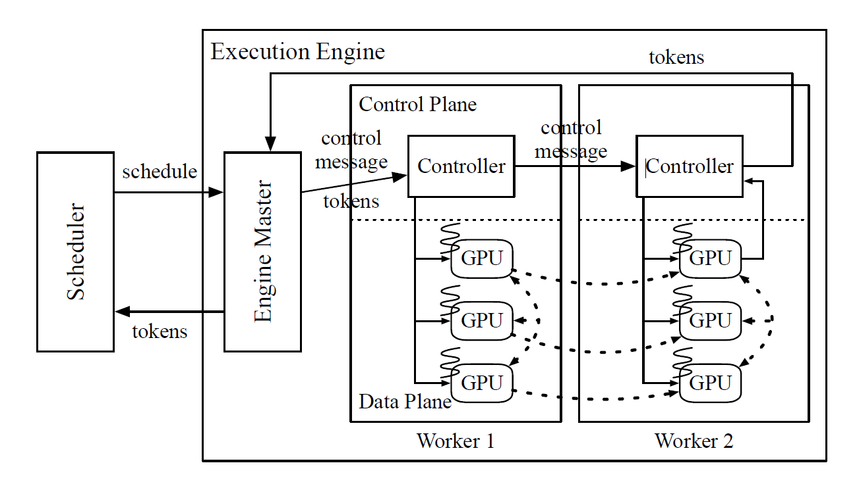
ORCA Architecture
Iteration-Level Scheduling: Schedules execution token-by-token rather than waiting for whole requests to finish. This allows new requests to join immediately and finished ones to leave instantly.
Selective Batching: Applies batching to most operations (like Linear layers) but processes Attention individually. This handles requests in different phases without padding or waiting.
Distributed Engine: Separates control (CPU) and data (GPU) planes to minimize synchronization overhead.
Performance: Achieves 36.9x higher throughput than NVIDIA FasterTransformer at the same latency.

Slide 8
vLLM

Slide 9
The Problem: KV Cache Memory Waste
During LLM inference, every generated token requires the Key and Value vectors of all previous tokens (KV Cache). Traditional systems pre-allocate a fixed contiguous block per request — leading to massive internal fragmentation.

Slide 10
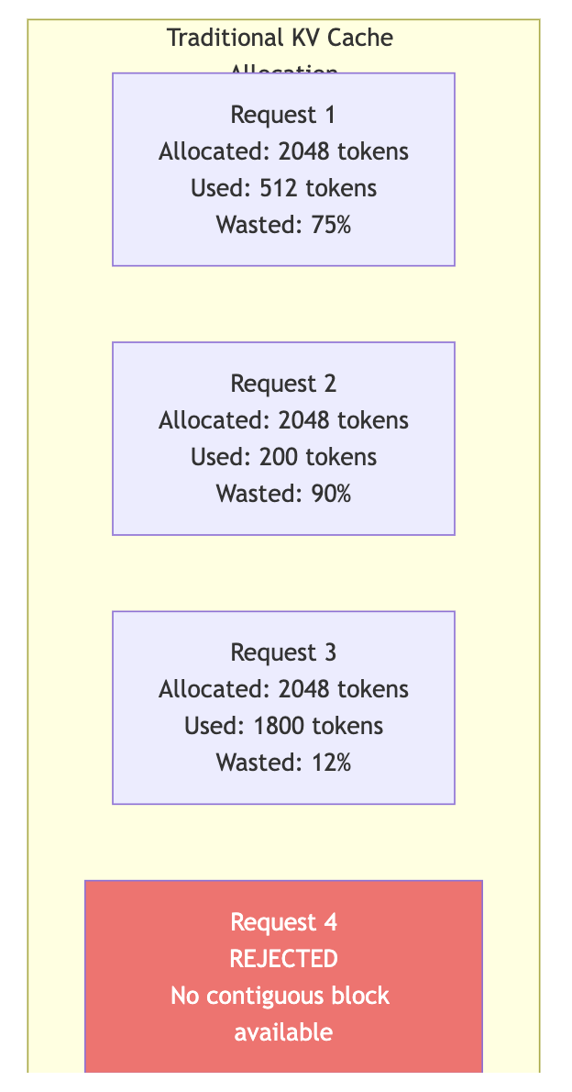

Slide 11
The Solution: PagedAttention
Inspired by OS Virtual Memory, PagedAttention splits KV Cache into fixed-size pages (blocks). Pages can be non-contiguous in physical GPU memory — just like virtual memory pages in RAM.

Slide 12
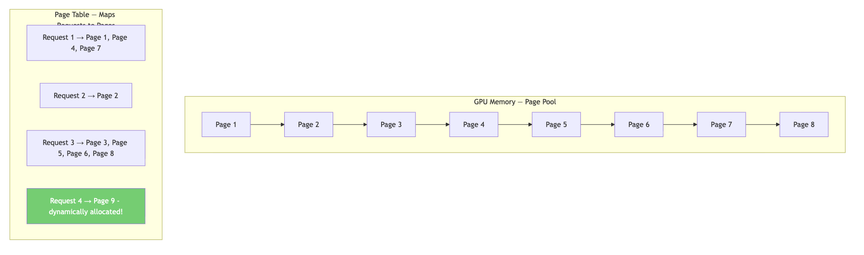

Slide 13
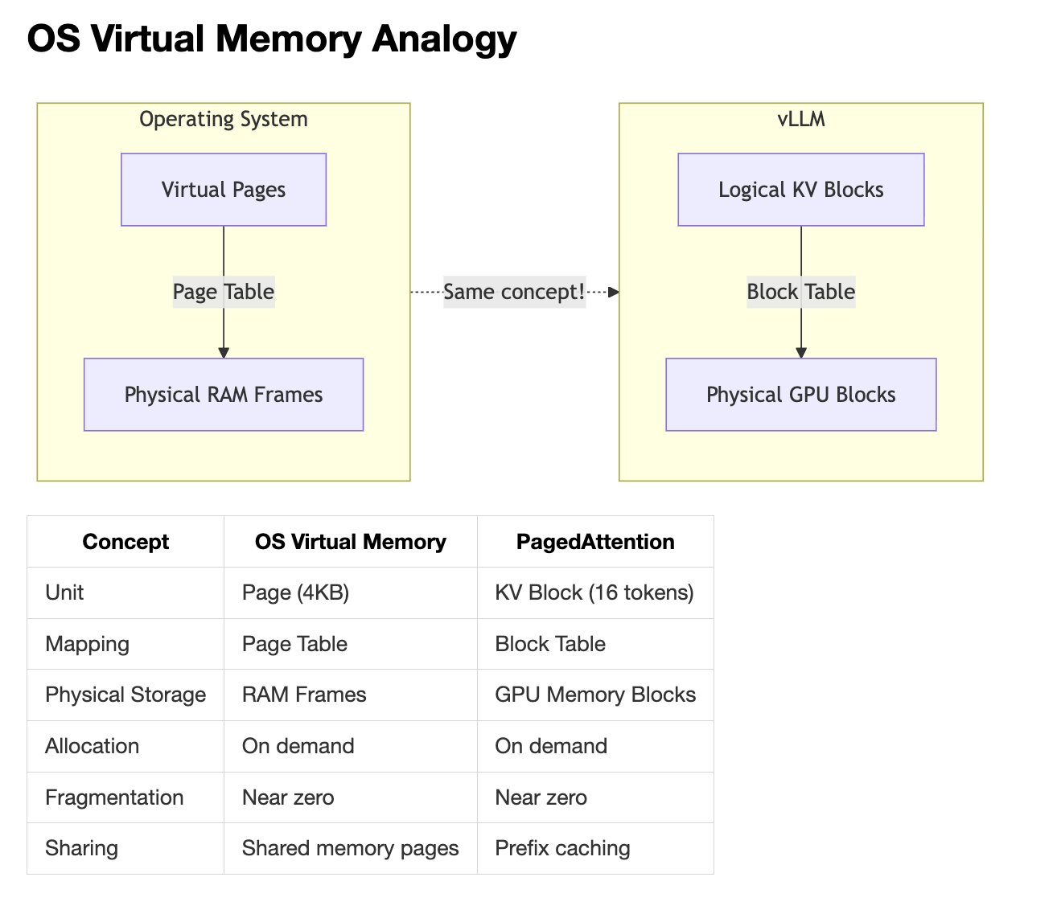

Slide 14
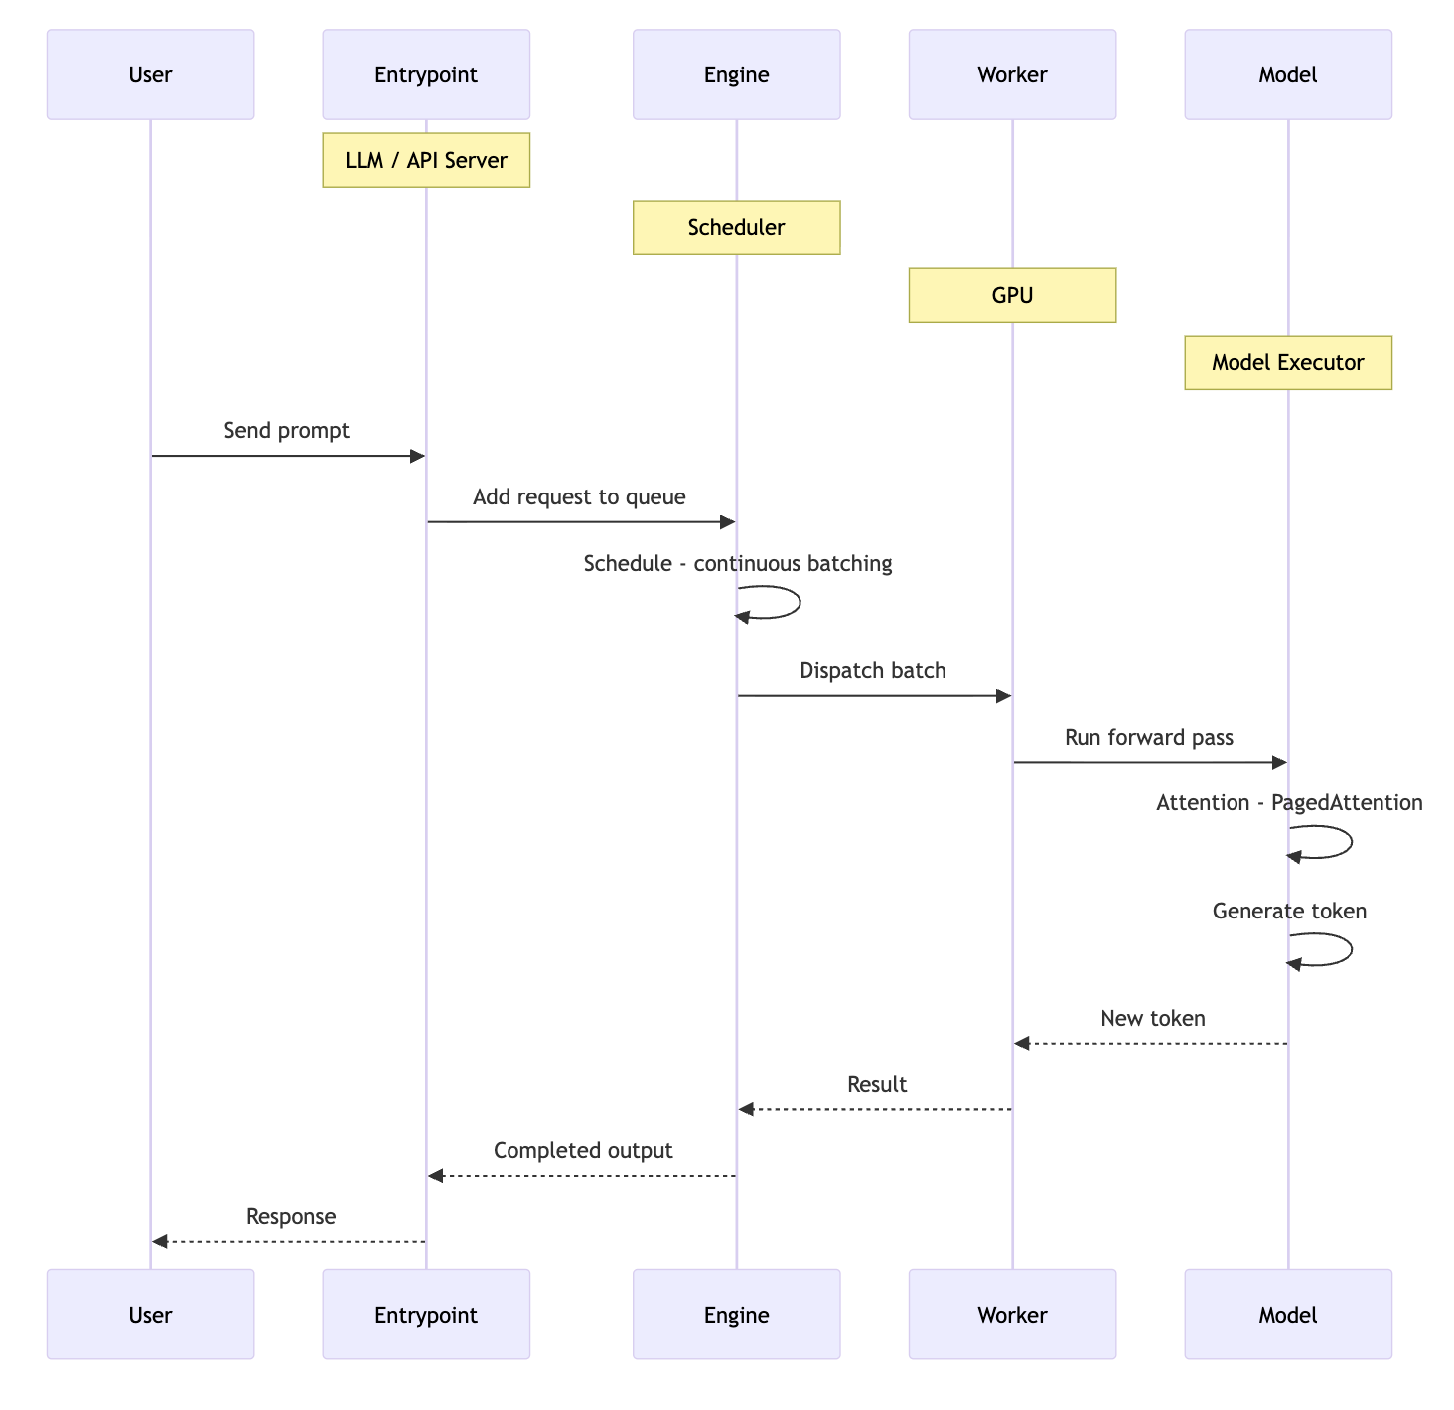

Slide 15
